Slide 1

Data as a Signal Data X: A Course on Data, Signals, and Systems
Data ^{X}
About Me:
Ikhlaq Sidhu Chief Scientist & Founding Director, Sutardja Center for Entrepreneurship & Technology IEOR Emerging Area Professor Award, UC Berkeley

Slide 2
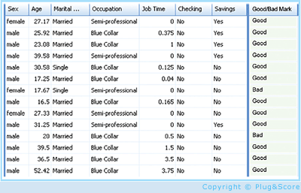
A High Level Framework
Features, but also loss of information
Some data has observed results
In Real Life
Objects
Events/Experiments
People/Customers
Products
Stocks
…
Person 1
Person 2
Person 3
.
.
.
Person N
In Sample
Out of Sample
Characteristics
Patterns
Models
Predictions
Similarities
Differences
Distance

Slide 3
Converting From Time Sequence Data to Features
Of course, not all data has a time property, but lets start with this type.
For example( key1, value 1),( key 2, value 2)… in this case, the keys are indexed by time.

Slide 4
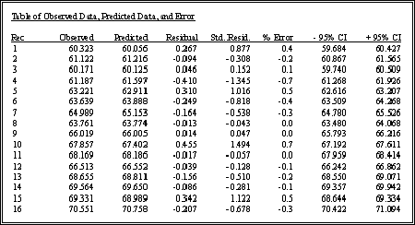
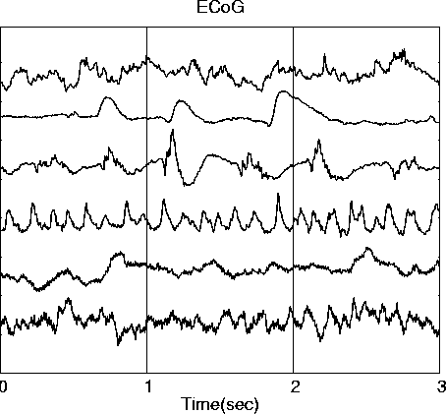
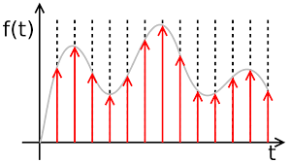
Converting From Time Sequence Data to Features
Many Types of data are signals in time
Stock market
Temperature
Instrument readings
Sometimes we sample them, record at intervals of T
We get a
list in a table, array, or vector
What we want (for now): features and characteristics
For example:
Means
Variances
Patten matches
Changes
accumulation
Frequency
Discrete data
x_{n} = x1, x2, x3, …
Continuous signals
x(t)
Sampled signals (data)
x(nT)
(might lose time reference)

Slide 5
Converting From Time Sequence Data to Features
Many Types of data are signals in time
Stock market
Temperature
Instrument readings
Sometimes we sample them, record at intervals of T
We get a
list in a table, array, or vector
What we want (for now): features and characteristics
For example:
Means
Variances
Patten matches
Changes
accumulation
Frequency
Discrete data
x_{n} = x1, x2, x3, …
Continuous signals
x(t)
Sampled signals (data)
x(nT)
(might lose time reference)

Slide 6
Converting From Time Sequence Data to Features
Many Types of data are signals in time
Stock market
Temperature
Instrument readings
Sometimes we sample them, record at intervals of T
We get a
list in a table, array, or vector
What we want (for now): features and characteristics
For example:
Means
Variances
Patten matches
Changes
accumulation
Frequency
Discrete data
x_{n} = x1, x2, x3, …
Continuous signals
x(t)
Sampled signals (data)
x(nT)
(might lose time reference)

Slide 7
Converting From Time Sequence Data to Features
Many Types of data are signals in time
Stock market
Temperature
Instrument readings
Sometimes we sample them, record at intervals of T
We get a
list in a table, array, or vector
What we want (for now): features and characteristics
For example:
Means
Variances
Patten matches
Changes
accumulation
Frequency
But from when, and over what time period
Discrete data
x_{n} = x1, x2, x3, …
Continuous signals
x(t)
Sampled signals (data)
x(nT)
(might lose time reference)

Slide 8
Approaches to the Data Sequences in Tables
Time ->
One row for each source
A, B, C, D..
Eg Numpy arrays
A: x1, x2, x3, …
B: x1, x2, x3, …
C: x1, x2, x3, …
D: x1, x2, x3, …
A
.
.
D
A
x1
x2
x3
.
.
B
x1
x2
x3
.
.
C
x1
x2
x3
.
.
One column
for each series:
A , B, C, D..
eg Pandas
(add rows with every new time sample)
1
2
3
.
.
Discrete data for
each source
A, B, C..
x_{n} = x1, x2, x3, …

Slide 9
Approaches to the Data Sequences in Tables
Time ->
One row for each source
A, B, C, D..
Eg Numpy arrays
A: x1, x2, x3, …
B: x1, x2, x3, …
C: x1, x2, x3, …
D: x1, x2, x3, …
Preprocess:
Filter/
Coevolution
Correlation
Mean, var, stats
Windows of time
A
If ML:
Table of (X,Y)
for
Prediction
Classification
.
.
Features
D
A
x1
x2
x3
.
.
B
x1
x2
x3
.
.
C
x1
x2
x3
.
.
One column
for each series:
A , B, C, D..
eg Pandas
(add rows with every new time sample)
1
2
3
.
.
Discrete data for
each source
A, B, C..
x_{n} = x1, x2, x3, …
Data Input and Storage
Preprocessing
ML for Decisions

Slide 10
Data Sequence in Tables Example
Preprocess:
Filter/
Convolution
Correlation
Mean, var, stats
Windows of time
 | Price | Price[n-20] | 20 day MA | 1 year average | Expected Price?
APPL | appl[n] | appl[n-20] | appl*h_20 | appl_1y()
FB | fb[n] | fb[n-20] | fb*h_20 | fb_1y()
GOOG | goog[n] | goog[n-20] | goog*h_20 | goog_1y()
Apple
.
.
Google
data
features
Discrete data for
each source
A, B, C..
x_{n} = x1, x2, x3, …
Data Input and
Temp Storage
Preprocess
(and lose
some information)
ML for Decisions / Predictions

Slide 11
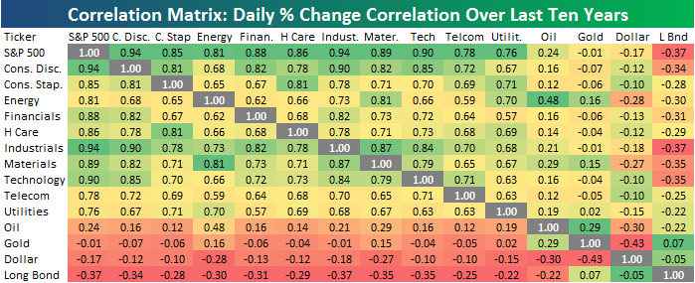
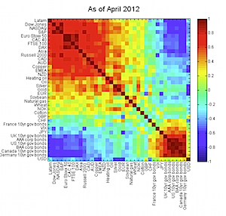
Data Sequence in Tables Example
Preprocess:
Filter/
Convolution
Correlation
Mean, var, stats
Windows of time
Apple
.
.
Google
data
features
Discrete data for
each source
A, B, C..
x_{n} = x1, x2, x3, …
Data Input and
Temp Storage
Preprocess
(and lose
some information)
Descriptive Statistics

Slide 12
Correlation Matricies

Slide 13
Correlation and Covariance

Slide 14
Correlation and Covariance
Properties

Slide 15
Covariance: Alternative Format

Slide 16
Correlation Matrix
Table
Window W
x1 x2 … xn
Samples
1
2
3
4
5
6
W
.
.
.
x1
Samples from Window of W
x2
xn
Many samples, or a sequence in time
x1(t), x2(t), .. xn(t)
To estimate from data:
Use all samples ever collected
Use window size of W samples of each to estimate a recent Corr Matrix

Slide 17
Correlation Matrix
Corr(x1,x1) = 1
Corr(x2, x1)
= E[ XY – E[X]E[y] ] / stdev(x) stdev(y)
You could even do this by hand:
Corr(x1,x1) ……..
Corr(x1,xn)
Corr(xn,x1)
x1 x2 E[x1 x2] E[x1] E[x2]
1 2 2 1.5 2.5 2 4 1 1 2 3
Corr(xn,xn)
To estimate from data:
Use all samples ever collected
Use window size of W samples of each to estimate recent Corr Matrix

Slide 18
Code Examples: Correlation of Rows with NumPy
Import numpy as np
x = [[0.1, .32, .2, 0.4, 0.8],
[.23, .18, .56, .61, .12],
[.9, .3, .6, .5, .3],
[.34, .75, .91, .19, .21]]
np.corrcoef(x)
Out[4]: array([
[ 1. , -0.35153114, -0.74736506, -0.48917666],
[-0.35153114, 1. , 0.23810227, 0.15958285],
[-0.74736506, 0.23810227, 1. , -0.03960706],
[-0.48917666, 0.15958285, -0.03960706, 1. ]
])
Here each row is a vector of length 5
There are 4 vectors
Correlation matrix is 4 x
If you want the correlation of the columns,
just use
np.corrcoef ( np.transpose(x) )
For a window, use a slice:
window = x[0:4,3:5] for the last
two columns

Slide 19
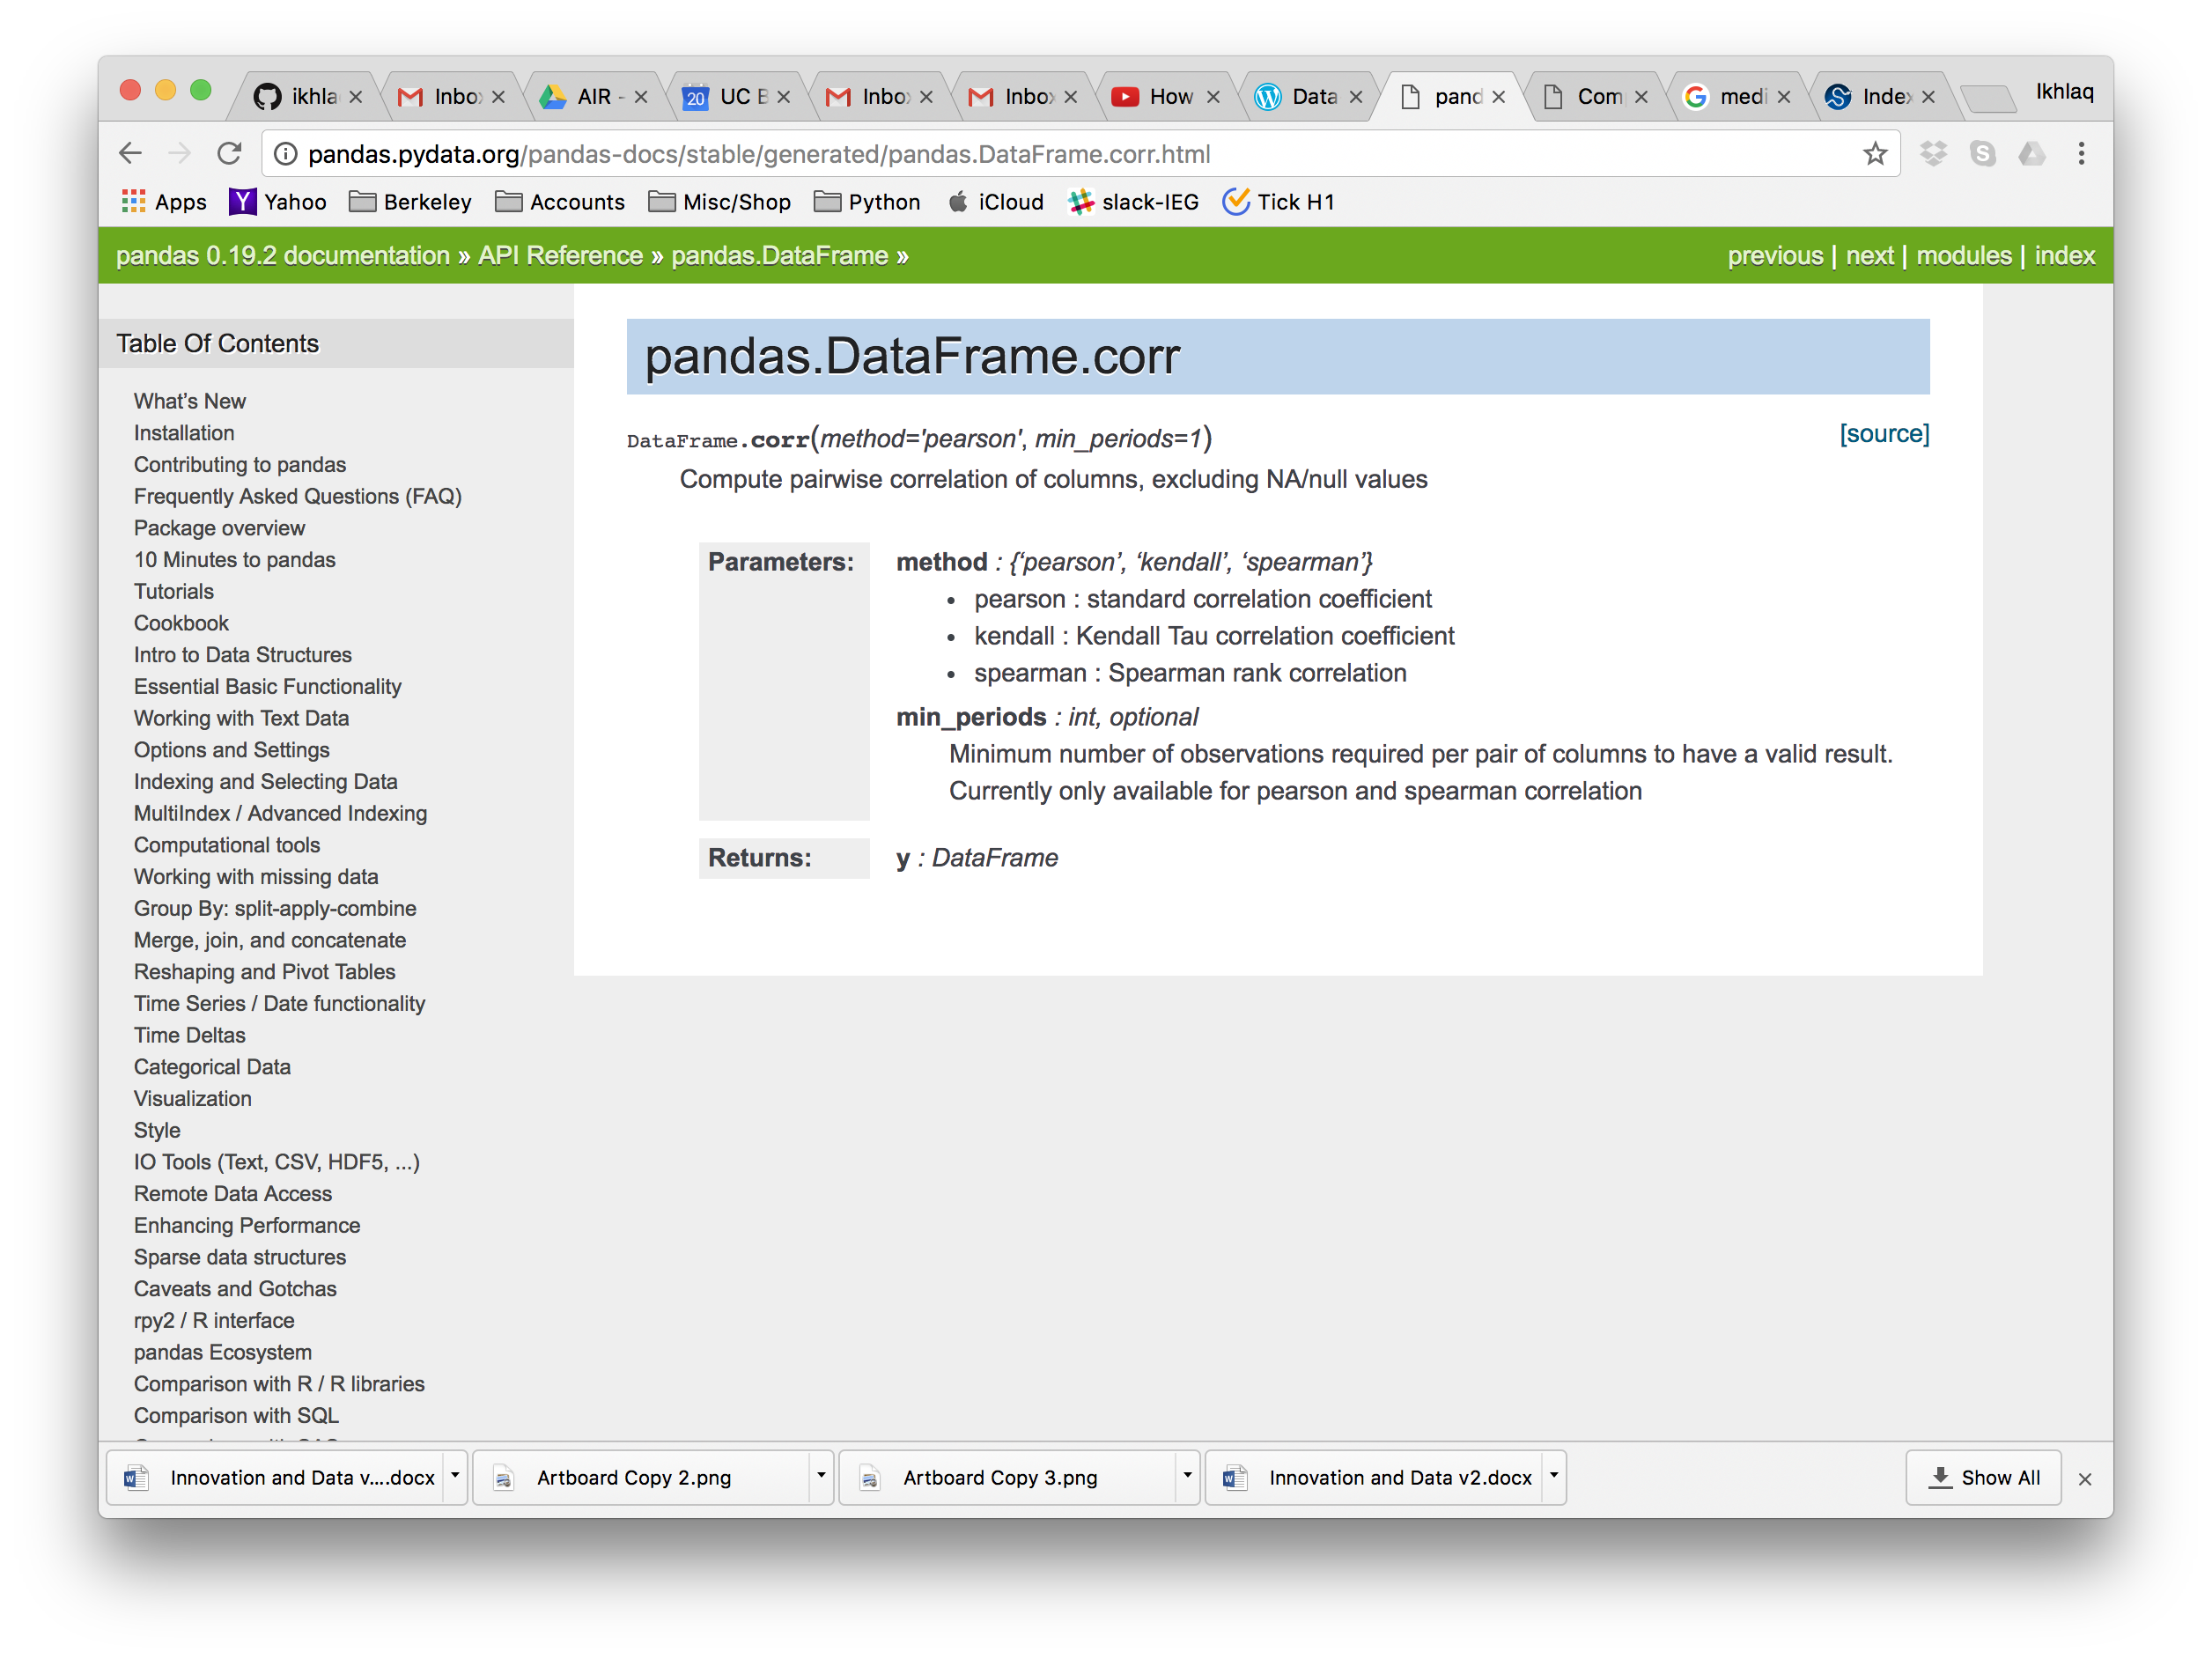
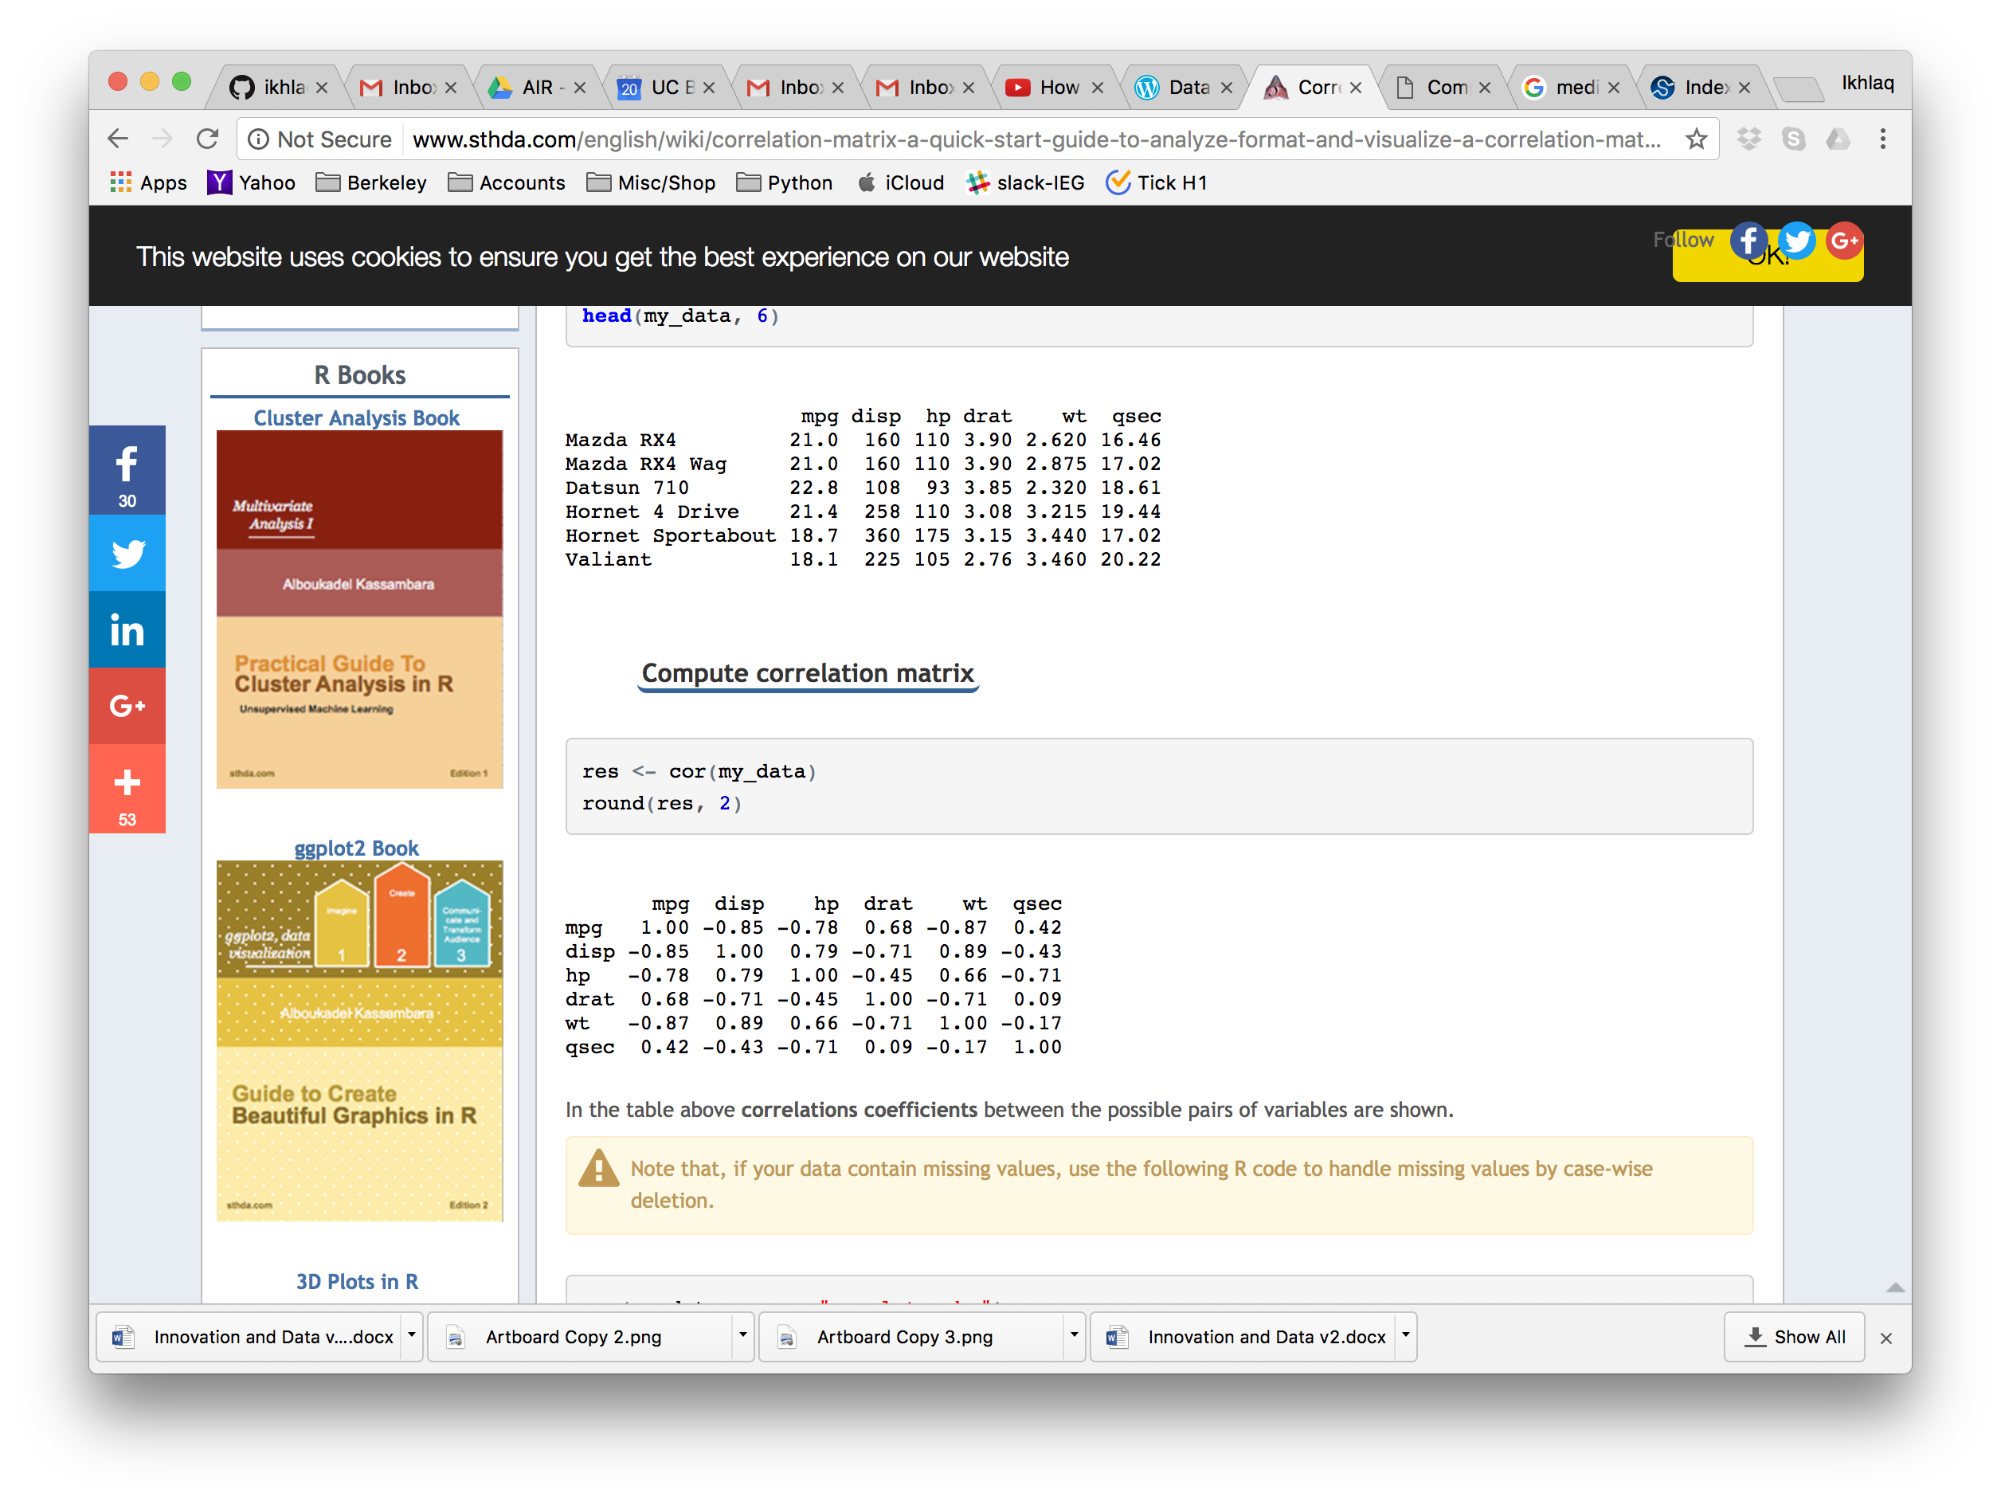
Correlation of Features from Different Sources
Pandas Table
Use corr()

Slide 20
Pandas will create a correlation matrix with “columns”

Slide 21
Properties of Correlation

Slide 22
Properties of Correlation

Slide 23
Properties of Correlation

Slide 24
More Conversions from Real Time Data
Single Signals (an array)
Fourier Tansform: DTFT and FFT -> features that have spectral information
Pattern Matching -> feature = does the pattern exist, or how strongly
More types of scoring: mapping a vector to a single number
Multiple Inputs (multiple arrays or a matrix)
Cross correlation matrix
Jacobian Matrix – What is causing the most change?

Slide 26
Signal Statistics and Windows

Slide 27
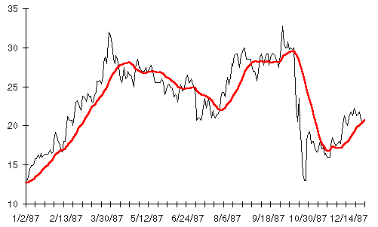
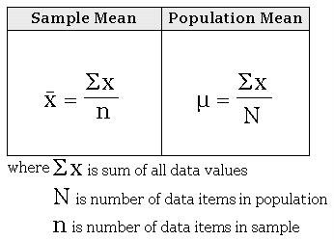
Simple things we can do with a sequence: Mean, Variance
Discrete data x_{n} = x1, x2, x3, …
variance
mean

Slide 28
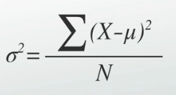
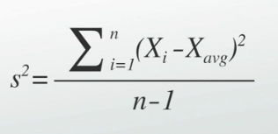
Simple things we can do with a sequence: Mean, Variance
Discrete data
x_{n} = x1, x2, x3, …
variance
mean
And of course, standard deviation is s or sigma

Slide 29
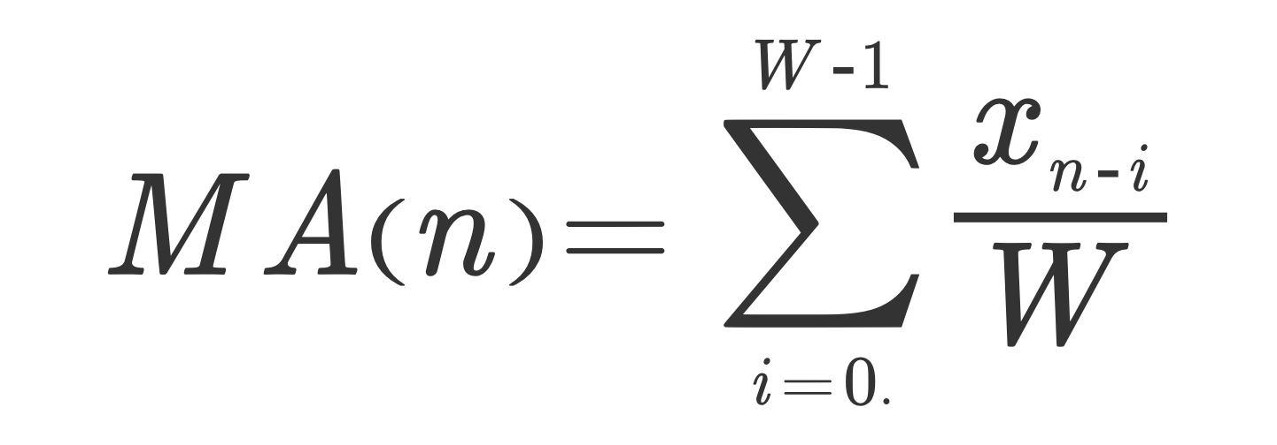
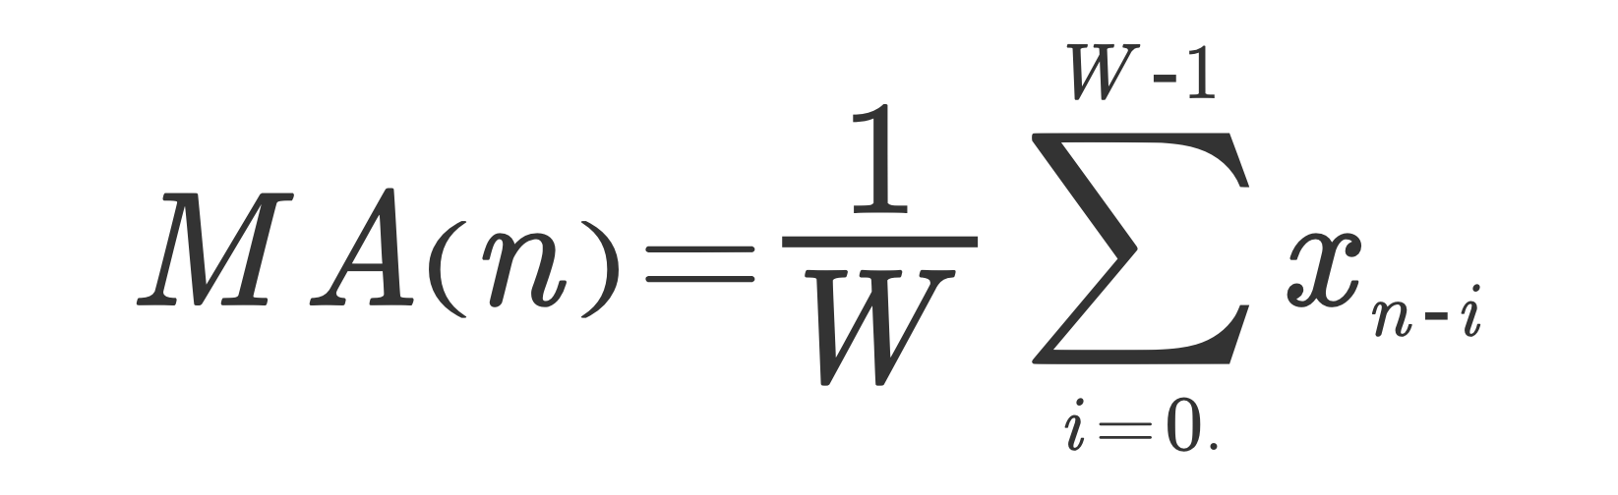
Moving Average of Sequence
(Simple) Moving Average
Discrete data x_{n} = x1, x2, x3, …
Moving Average
W =size of window
MA(n) is red line, at the right edge
of the window
Note:
* It’s a function of n (and maybe W)
* Its smoother than the
original (low pass filter)
W = window size, can be
in the summation
Notes:
The reason we use n-1 rather than n is so that the sample variance will be what is called
an unbiased estimator of the population variance (sigma squared)

Slide 30
LTI Approaches

Slide 31
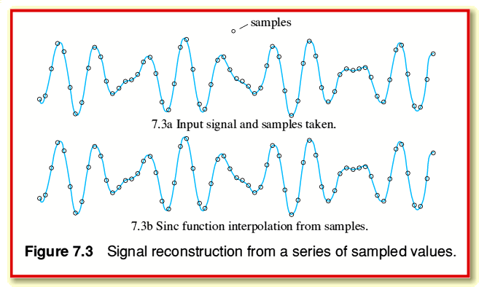
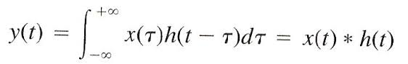
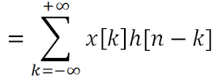
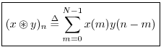
Another Way to Think about Moving Average
x(t)
LTI:
h(n)=1,1,1,1
y[n] is similar to moving average
with window of 4
x(t)
x(n) = array with sequence of numbers = [10, 3, 6, 12, …. … 43, 12, 1, 4]
h(n) = impulse response function from linear systems
= [1, 1, 1, 1]
MA*W = y(n) = x(t) * h(t) (convolution)
Continuous
y[n]
Circular

Slide 32
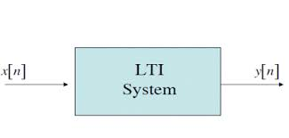
Linear Time Invariant System
x[n]
y[n]
1
1
.5
time
time
0 1 2 3
0 1 2 3
h[n]
1
.5
0 1 2 3
time
Impulse (delta function: area = 1, width -> 0, height -> ∞)
In discrete systems, its just a value of “1”
Impulse response
y[n]
1
x[n]
.5
0.5
.25
0 1 2 3
0 1 2 3

Slide 33
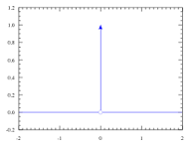
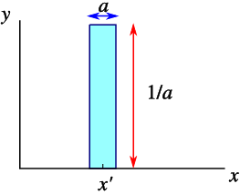
Aside on Delta Functions
x[n]
y[n]
1
1
.5
time
time
0 1 2 3
0 1 2 3
h[n]
1
.5
0 1 2 3
time
Impulse (delta function: area = 1, width -> 0, height -> ∞)
In discrete systems, its just a value of “1”
Impulse response
y[n]
1
x[n]
.5
0.5
.25
0 1 2 3
0 1 2 3

Slide 34
Linear Time Invariant System
x[n]
y[n]
1
1
.5
0 1 2 3
0 1 2 3
h[n]
1
.5
0 1 2 3
Impulse response
y[n]
1
x[n]
.5
0.5
.25
0 1 2 3
0 1 2 3

Slide 35
Convolution is actually really simple, but powerful
y[n] = x[n] * h[n]
x[[n] = 1 2 3 2 4 0 0 0 …
h[n] = 1 1 1
y[n] = 1 1 1
2 2 2
3 3 3
2 2 2
4 4 4
---------------------------------------------
y[n] =1 3 6 7 9 6 4 …
h[n-0] x[0]
h[n-1] x[1]
h[n-2] x[2]
h[n-3] x[1]
h[n-1] x[1]
Note, MA with Window = 3 (if divided by 3)
Note: if h[n] = 1/3, 1/3, 1/3, then y[n] = 1/3, 1, 2, 7/3, 3, 2, 4/3

Slide 36
Another Convolution, different impulse response
y[n] = x[n] * h[n]
x[[n] = 1 2 3 2 4 0 0 0 …
h[n] = 3 2 1
y[n] = 3 2 1
6 4 1
9 6 1
6 4 1
12 8 4
---------------------------------------------
y[n] =3 8 14 13 17 9 4 …
h[n-0] x[0]
h[n-1] x[1]
h[n-2] x[2]
h[n-3] x[1]
h[n-1] x[1]
This is called filtering the data with an FIR filter with impulse response h[n] = 3 2 1

Slide 37
Code Example of Convolution
>>> np.convolve([1, 2, 3], [0, 1, 0.5])
array([ 0. , 1. , 2.5, 4. , 1.5])
numpy.convolve(a, v, mode='full')[source]
Returns the discrete, linear convolution of two one-dimensional sequences.
The convolution operator is often seen in signal processing, where it models the effect of a linear time-invariant system on a signal [R17]. In probability theory, the sum of two independent random variables is distributed according to the convolution of their individual distributions.
Notes:
The discrete convolution operation is defined as
(a * v)[n] = \sum_{m = -\infty}^{\infty} a[m] v[n - m]
It can be shown that a convolution x(t) * y(t) in time/space is equivalent to the multiplication X(f) Y(f) in the Fourier domain, after appropriate padding (padding is necessary to prevent circular convolution). Since multiplication is more efficient (faster) than convolution, the function scipy.signal.fftconvolve exploits the FFT to calculate the convolution of large data-sets.

Slide 38
Convolution: why we care
Take Any Input Sequence x[n]
Filter for what you want with h[n]
Get result y[n]
FIR:
Finite Impulse
Response Filter
h[n] Result
1/W,1/W,1/W,1/W Low pass filter or moving average, with 1/W cutoff
(a1,a2,…a10) Any linear weighted sum
1, -1 Differential
Any sequence Cross-correlation, allows you to look for similar pattern

Slide 39
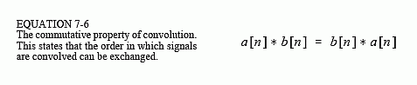
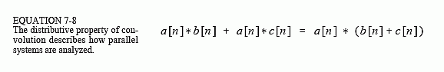
Properties of Convolution

Slide 40
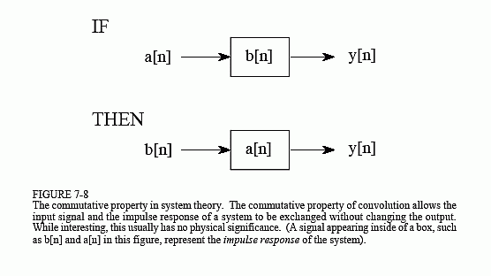

Slide 41
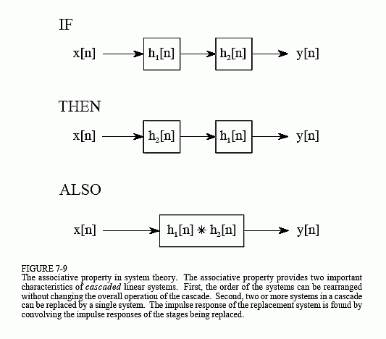

Slide 42
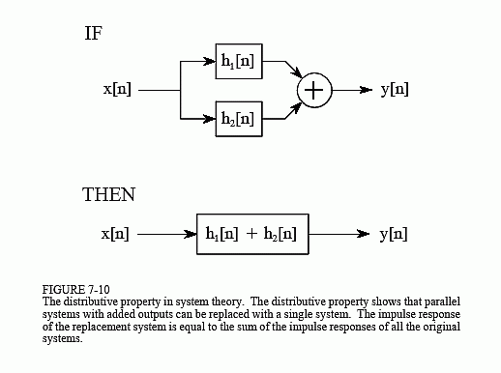

Slide 43
FIR Code Example with Convolution

Slide 44
Another LTI System
Discrete data x_{n} = x1, x2, x3, …
Another LTI System
x[n]
a
+
y[n]
Delay 1 (1-a)
alpha = smoothing factor of 2/(W+1)
W is number of time periods
Infinitely back in x[n]
W =size of window
mean
Notes:
An exponential moving average (EMA) is a type of moving average that is similar to a simple moving average, except that more weight is given to the latest data. It's also known as the exponentially weighted moving average. This type of moving average reacts faster to recent price changes than a simple moving average.

Slide 45
Another LTI System:
Discrete data x_{n} = x1, x2, x3, …
Another LTI System
x[n]
a
+
y[n]
Delay 1 (1-a)
Exponential Moving Average
alpha = smoothing factor of 2/(W+1)
W is number of time periods
Infinitely back in x[n]
IIR:
Infinite Impulse
Response Filter
W =size of window
mean
Notes:
An exponential moving average (EMA) is a type of moving average that is similar to a simple moving average, except that more weight is given to the latest data. It's also known as the exponentially weighted moving average. This type of moving average reacts faster to recent price changes than a simple moving average.

Slide 46
IIR Code Example with Convolution

Slide 47
Example in Quant Finance
Stock Prices
appl[n]
fb[n]
goog[n]
n = today, n-1 = yesterday, etc.
Convert to this form, rows = companies, columns = features
 | Price | Price[n-20] | 20 day MA | 1 year average | Expected Price?
APPL | appl[n] | appl[n-20] | appl*h_20 | appl_1y()
FB | fb[n] | fb[n-20] | fb*h_20 | fb_1y()
GOOG | goog[n] | goog[n-20] | goog*h_20 | goog_1y()

Slide 48
End of Section

Slide 49
What could stock FB be priced today?
Group_Average_1 year
= (FB_1YearAve + GOOG_1YearAve + AAPL_1YearAve)/3
Group_Average_today[n] = (fb[n]+goog[n]+aapl[n])/3
Today’s price could be predicted as the same ratio as over the past year:
FB-1 year FB-today
------------ = ------------
Group-1 year group today
fb_exp[n] = Group_Average_today * fb[n]/Group_Average_1 year
goog_exp[n] = Group_Average_today * goog[n]/Group_Average_1 year
Apple_exp[n] = Group_Average_today * aapl[n]/Group_Average_1 year
Difference [n] = fb[n] – fb_exp[n]

Slide 50
Example in Quant Finance: Limits of LTI Systems
Stock Prices: appl[n], fb[n], goog[n]
n = today, n-1 = yesterday, etc.
 | Price | Price[n-30] | 1 year average | median | Expected Price today[n]
APPL | appl[n] | appl[n-20] | appl_1y() | appl_med() | appl-exp[n]
FB | fb[n] | fb[n-20] | fb_1y() | fb_med() | fb-exp[n]
GOOG | goog[n] | goog[n-20] | goog_1y() | goog_md() | goog-exp[n]
These features can be
Calculated by LTI systems
These are not, eg. median and many others

Slide 51
Example in Quant Finance: Training on the past
Stock Prices: appl[n], fb[n], goog[n]
n = today, n-1 = yesterday, etc.
Now try with n’ = n-60 ( 3 months ago)
 | Price[n’] | Expected Price today[n’] | Price at n’+60 How did it turn out
APPL | appl[n] | appl-exp[n] | +10% | Error?
FB | fb[n] | fb-exp[n] | +15% | Error?
GOOG | goog[n] | goog-exp[n] | -5% | Error?
You could train on the last quarter to know how well the algorithm does
More on that later

Slide 52
Code Example and Homework

Slide 53
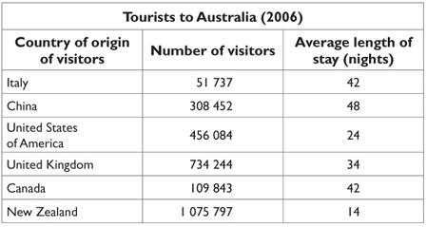
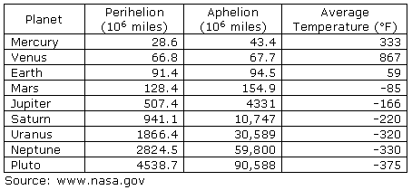
Summary: Time Varying Data Signals to Features
Features, but also loss of information
In Real Life
Objects
Events/Experiments
People/Customers
Products
Stocks
…
Person 1
Person 2
Person 3
.
.
.
Person N
In Sample
Out of Sample
Time Varying Signals to Features
Characteristics
Patterns
Models
Predictions
Similarities
Differences
Distance
CS: Table
Math: Matrix X, which is
N rows – each person
m columns, each feature (age, salary, ..)

Slide 54
Data as a Signal Data X: A Course on Data, Signals, and Systems
Data ^{X}
About Me:
Ikhlaq Sidhu Chief Scientist & Founding Director, Sutardja Center for Entrepreneurship & Technology IEOR Emerging Area Professor Award, UC Berkeley

Slide 55
Outline for Data as a Signal Part II
Fourier and Spectral Analysis
Comb Function, and why this is so important
Resampling

Slide 56
Part II: LTI and Data Signals to Features
Features, but also loss of information
In Real Life
Objects
Events/Experiments
People/Customers
Products
Stocks
…
Person 1
Person 2
Person 3
.
.
.
Person N
In Sample
Out of Sample
Time Varying Signals to Features
Characteristics
Patterns
Models
Predictions
Similarities
Differences
Distance

Slide 57
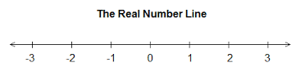
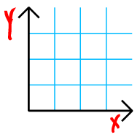
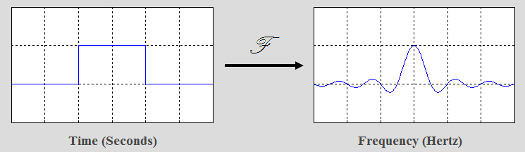
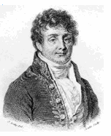
Fourier Transform The most famous of mathematical transfoms
f(x)
g(x)
x
y = f(x) = x+1
f()
y
A Transform is not a function: ie mapping from one variable to another
Notes:
Functions can be 1:1, and onto

Slide 58
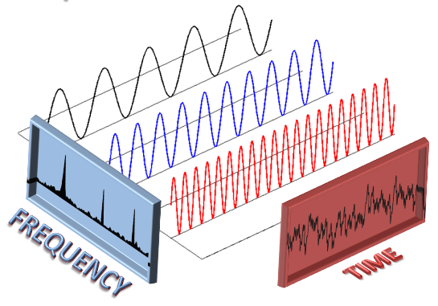
Fourier Transform
Mapping from a time
to frequency, and back.
groups.csail.mit.edu/netmit/wordpress/projects/sparse-fourier-transform/

Slide 59
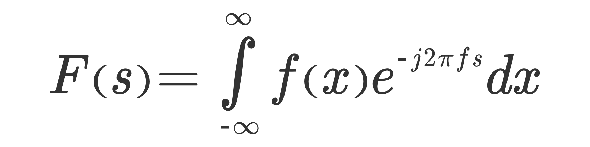
In more detail
x or t = time, f(x) is a function of time
i or j are for imaginary numbers. Note F and f are both complex functions.
f or s is often used for frequency, so F(s) is a function in frequency
Integrate (average) over all time (for every given frequency)

Slide 60
In more detail
Remember that

Slide 61
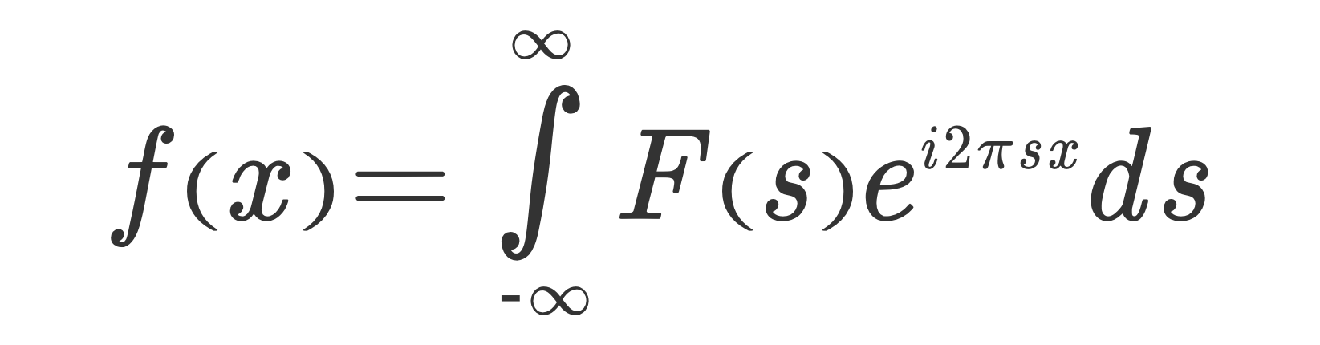
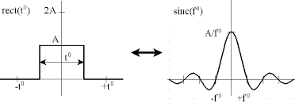
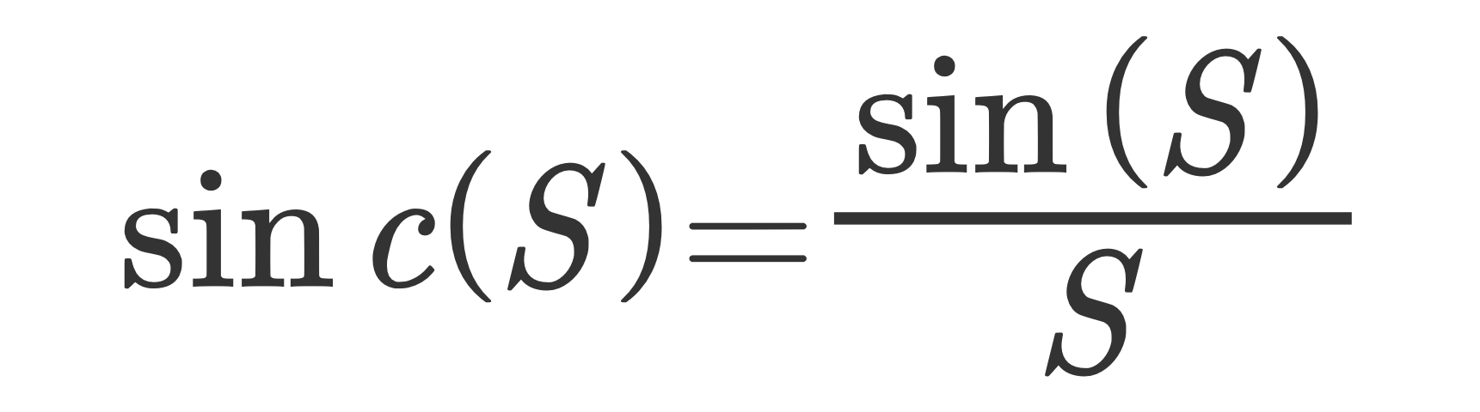
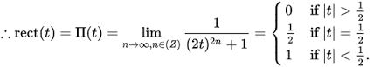
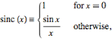
Fourier Basics
This example is the famous rect(x) which transforms to Sinc(s)
S=f in the graph
http://www.thefouriertransform.com/

Slide 62
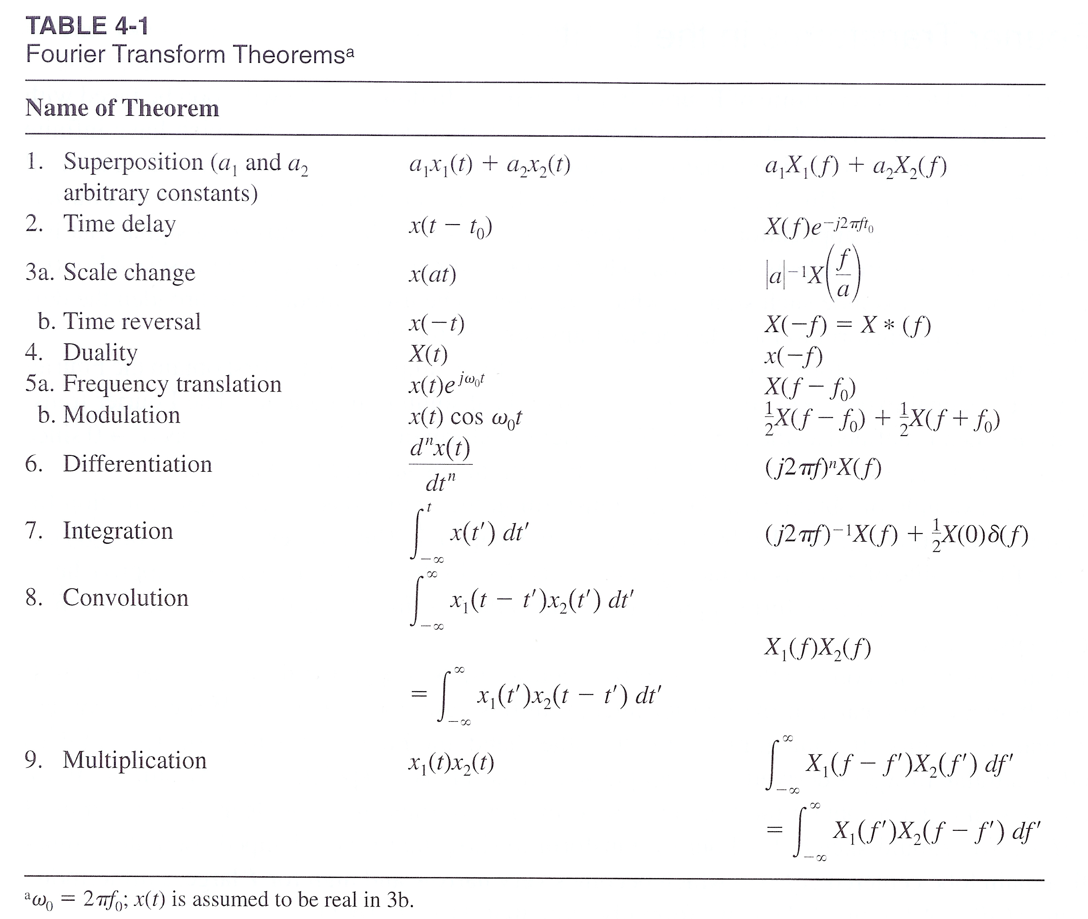
As written in virtually every book on Fourier or Systems..

Slide 63
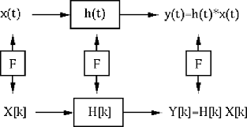
And of course, there is a famous link between Fourier, LTI, and Convolution:

Slide 64
So that’s all great, but what about data?
>>> from scipy.fftpack import fft, ifft
>>> x = np.array([1.0, 2.0, 1.0, -1.0, 1.5])
>>> y = fft(x)
>>> y
array([ 4.50000000+0.j , 2.08155948-1.65109876j,
-1.83155948+1.60822041j, -1.83155948-1.60822041j,
2.08155948+1.65109876j])
>>> yinv = ifft(y)
>>> yinv
array([ 1.0+0.j, 2.0+0.j, 1.0+0.j, -1.0+0.j, 1.5+0.j])

Slide 65
So that’s all great, but what about data?
>>> np.fft.fft(np.exp(2j * np.pi * np.arange(8) / 8))
array([ -3.44505240e-16 +1.14383329e-17j,
8.00000000e+00 -5.71092652e-15j,
2.33482938e-16 +1.22460635e-16j,
1.64863782e-15 +1.77635684e-15j,
9.95839695e-17 +2.33482938e-16j,
0.00000000e+00 +1.66837030e-15j,
1.14383329e-17 +1.22460635e-16j,
-1.64863782e-15 +1.77635684e-15j])

Slide 66
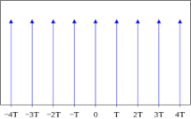
But wait, that was discrete, and Fourier was continuous
This is the comb function:

Slide 67
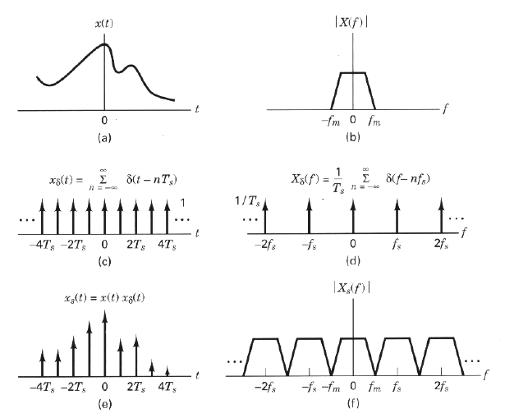
By understanding the properties of the Comb, we can map between the time signal and the frequency samples
Sampled with time T, and with N samples means:
Each frequency bin in the FFT = 1/(T*N)
http://docs.exdat.com/docs/index-44055.html

Slide 68
Code Examples
FFT of weather data
Find the timing cycles
Comments:
Note fft(0) = mean f(t)
f(0) = mean FFT(s)

